Slide 1
Fetal Health Classification using Cardiotocogram (CTG) Data
Course & Section No:- Data Mining(CS634002
By:- Dhruv Patel(dp972)(dp972@njit.edu)
Submitted To: Professor Senjuti Basu Roy

Slide 2
Problem Statement
Maternal and child mortality remain significant global health challenges, particularly in low-resource settings. According to the World Health Organization, an estimated 295,000 women died in 2017 due to complications related to pregnancy and childbirth, with 94% of these deaths occurring in developing regions. Similarly, the United Nations Sustainable Development Goals (SDGs) emphasize reducing under-5 child mortality to fewer than 25 deaths per 1,000 live births by 2030. A key factor in achieving these targets is the early and accurate assessment of fetal health to allow timely medical intervention.
Cardiotocograms (CTGs) provide a low-cost, non-invasive method to monitor fetal well-being by capturing essential parameters such as fetal heart rate (FHR), uterine contractions, and fetal movements. However, interpreting CTG data manually can be subjective and prone to errors, particularly in resource-constrained environments with limited access to trained specialists.
This project aims to develop an intelligent machine learning model to classify fetal health conditions—Normal, Suspect, or Pathological—based on features derived from CTG data. Automating this classification process enhances diagnostic accuracy, supports timely medical decisions, and ultimately contributes to reducing preventable maternal and neonatal deaths. This work aligns with global health goals by leveraging data science to drive impactful clinical outcomes.

Slide 3
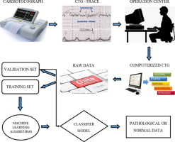
Data Mining Task
1. Classification
Goal: Predict fetal health status (Normal, Suspect, Pathological)
Models: Random Forest, Logistic Regression, XGBoost
2. Feature Selection
Method: Pearson correlation with p-value filtering
Result: Top 10 most relevant features selected
3. Clustering
Goal: Discover hidden patterns without labels
Method: K-Means with k = 5, 10, 15 + PCA for 2D visualization
4. Data Balancing
Method: SMOTE (Synthetic Minority Over-sampling Technique)
Purpose: Improve prediction on minority classes
5. Evaluation & Visualization
Tools: Confusion Matrix, ROC AUC, F1 Score, PR AUC
Purpose: Assess and compare model performance

Slide 4
How Did You Solve Each Task ?
1. Classification
Used supervised learning to classify fetal health as Normal, Suspect, or Pathological.
Trained three models:
  Random Forest – handled non-linearity and performed best overall.
  Logistic Regression – used as a baseline model.
  XGBoost – gradient boosting classifier with strong accuracy and efficiency.
2. Feature Selection
Applied Pearson correlation to find relationships between each feature and the target (fetal_health).
Selected top 10 features based on correlation strength and statistical significance (p < 0.1).
Reduced dimensionality and improved model interpretability.

Slide 5
3. Clustering
Performed unsupervised K-Means clustering to group data without labels.
Used PCA to reduce features to 2D for visualization.
Tested with k = 5, 10, 15 to explore different group structures.
4. Data Balancing
Identified class imbalance (majority: Normal).
Applied SMOTE (Synthetic Minority Over-sampling Technique) on training data.
Generated synthetic samples for underrepresented classes (Suspect, Pathological) to balance the dataset.
5. Evaluation & Visualization
Measured model performance using:
  Confusion Matrix – showed correct vs incorrect predictions.
  ROC AUC – tested overall separability across classes.
  F1 Score – focused on precision/recall balance.
  PR AUC – evaluated under class imbalance.
6. Visualized:
  Class distributions, model predictions, and clusters to interpret results effectively.

Slide 6
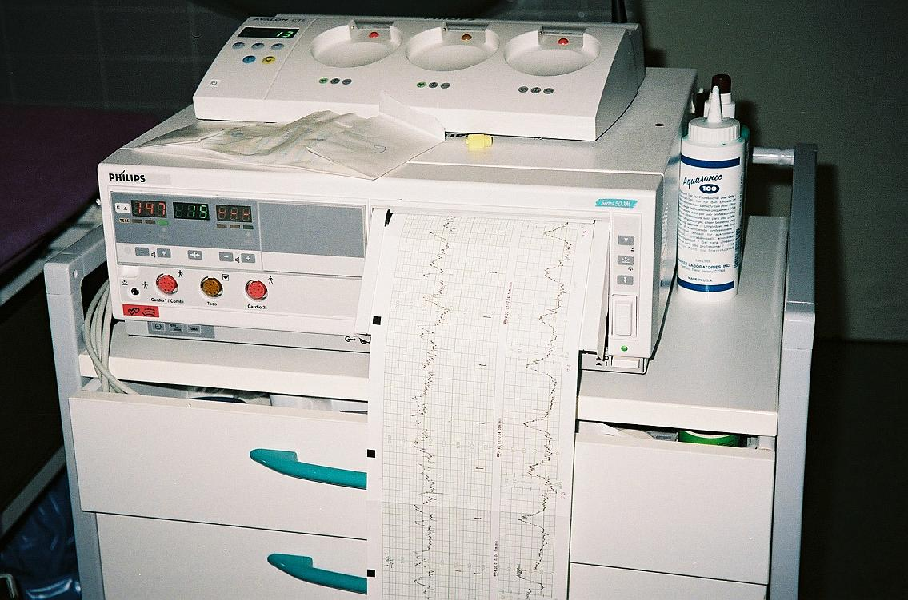
Let’s now go through the code

Slide 7

Results

Slide 8
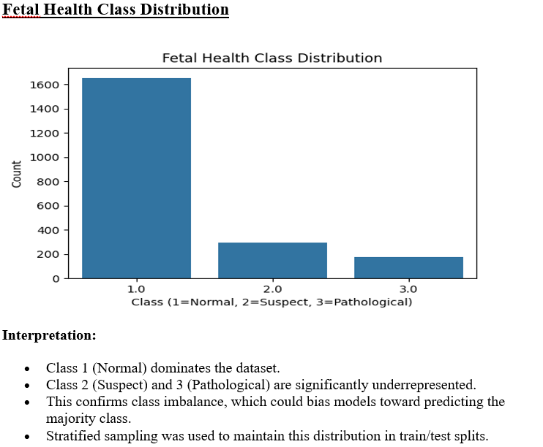

Slide 9
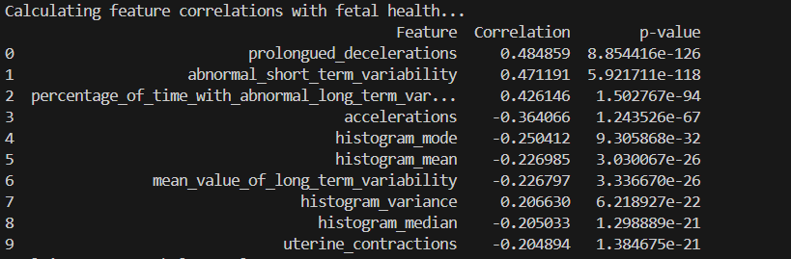
Top Positively Correlated Features (Risk Indicators)
Prolongued Decelerations (r = 0.48)
  Strongest correlation with poor fetal health. Frequent or long decelerations in heart rate are serious indicators of distress.
Abnormal Short-Term Variability (r = 0.47)
  Indicates irregular fluctuations in fetal heart rate; highly associated with pathological states.
Percentage of Time with Abnormal Long-Term Variability (r = 0.43)
  Extended periods of abnormal variability suggest long-term fetal compromise.
Histogram Variance (r = 0.21)
  Increased variability in the fetal heart rate histogram may reflect instability in the fetus.
Top Negatively Correlated Features (Healthy Indicators)
Accelerations (r = -0.36)
  Healthy fetuses typically show more heart rate accelerations; fewer accelerations are linked with distress.
Histogram Mode, Mean, and Median (r ≈ -0.25 to -0.20)
  Lower values of these central tendency measures suggest pathological trends in heart rate distribution.
Mean Value of Long-Term Variability (r = -0.23)
  Consistently lower values are linked to compromised fetal conditions.
Uterine Contractions (r = -0.20)
  Slight inverse relationship; could be due to complex interaction effects with other features.
This analysis identifies the 10 most influential features that are statistically correlated with fetal health. A positive correlation indicates a higher value of the feature is associated with poorer fetal health (moving toward class 3), while a negative correlation indicates the opposite.

Slide 10
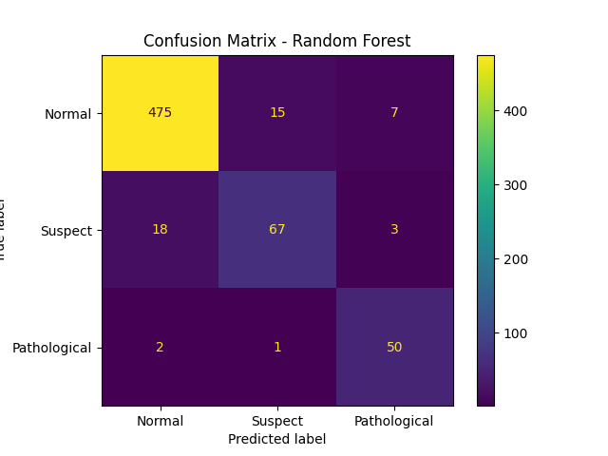
True Positives:
Normal: 475
Suspect: 67
Pathological: 50
· Misclassifications:
18 instances of Suspect were incorrectly classified as Normal.
15 instances of Normal were misclassified as Suspect.
3 instances of Suspect were misclassified as Pathological.
7 instances of Normal were misclassified as Pathological.
2 instances of Pathological were misclassified as Normal.
1 instance of Pathological was misclassified as Suspect.
· Observations:
Very high performance for Normal and Pathological classes.
Minimal confusion across classes, though Suspect remains more ambiguous.

Slide 11
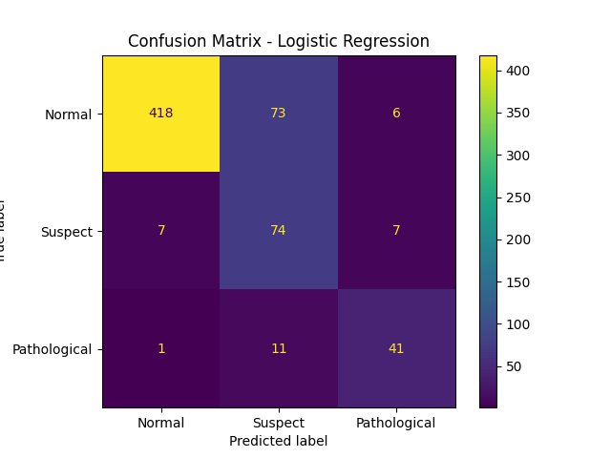
· True Positives:
Normal: 418
Suspect: 74
Pathological: 41
· Misclassifications:
73 instances of Normal were misclassified as Suspect.
7 instances of Suspect were misclassified as Normal.
7 instances of Suspect were misclassified as Pathological.
6 instances of Normal were misclassified as Pathological.
1 instance of Pathological was misclassified as Normal.
11 instances of Pathological were misclassified as Suspect.
· Observations:
Reasonable classification of Suspect.
Notable confusion between Normal and Suspect.
Struggles slightly more with Pathological classification.

Slide 12
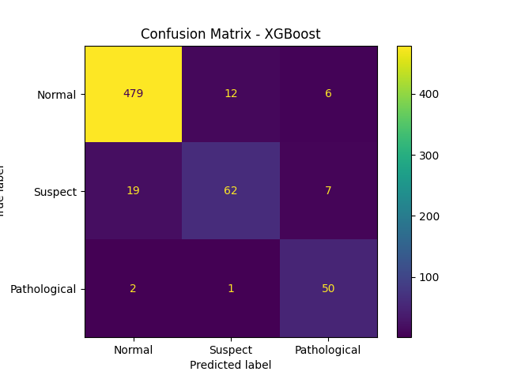
True Positives:
  Normal: 479
  Suspect: 62
  Pathological: 50
Misclassifications:
  19 instances of Suspect were misclassified as Normal.
  12 instances of Normal were misclassified as Suspect.
  7 instances of Suspect were misclassified as Pathological.
  6 instances of Normal were misclassified as Pathological.
  2 instances of Pathological were misclassified as Normal.
  1 instance of Pathological was misclassified as Suspect.
Observations:
  Comparable performance to Random Forest.
  Strong classification for Normal and Pathological.
  Slightly more confusion in identifying Suspect cases.

Slide 13
General Observations:
Pathological Classification:
  All models perform strongly on the Pathological class.
  Random Forest and XGBoost especially show minimal to no misclassifications.
  Logistic Regression shows slightly more confusion, but still reasonable performance.
Normal vs. Suspect Confusion:
  The main challenge across all models lies in distinguishing Normal and Suspect classes.
  Logistic Regression particularly struggles, with high misclassification of Normal as Suspect (73 instances).
  Random Forest and XGBoost perform significantly better in reducing these errors.
Model Robustness:
  Random Forest and XGBoost demonstrate stronger robustness and higher overall accuracy, particularly in imbalanced data scenarios.
  Logistic Regression, while interpretable and simpler, is less capable in this multi-class setting with overlapping class distributions.

Slide 14

Random Forest
ROC AUC: 0.9785, F1 Score: 0.9276, PR AUC: 0.9361
Achieved the best overall performance across all metrics.
Demonstrates strong capability to distinguish between classes and handle imbalanced data.
XGBoost
ROC AUC: 0.9763, F1 Score: 0.9251, PR AUC: 0.9275
Performs very closely to Random Forest, showing excellent precision and recall.
Suitable for deployment due to speed, accuracy, and efficiency.
🔹 Logistic Regression
ROC AUC: 0.9440, F1 Score: 0.8522, PR AUC: 0.8186
Lowest performance among the three models, especially in PR AUC, indicating weaker prediction on minority classes.
Still useful as a baseline, but less effective for imbalanced multiclass data
Conclusion:-
Both Random Forest and XGBoost are highly effective for fetal health classification, with Random Forest slightly outperforming. Logistic Regression, while interpretable, struggles with class imbalance and complex patterns, making it less suitable for this task.

Slide 15
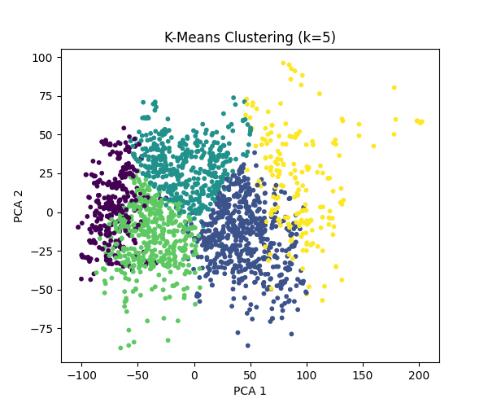
Clustering with k = 5
The clusters are relatively well-separated, indicating some structure in the data.
There are five distinguishable regions, suggesting possible subgroups in the fetal health data.
The choice of k=5 provides good separation without too much overlap, which could align with physiological subcategories beyond the three main health labels (Normal, Suspect, Pathological).

Slide 16
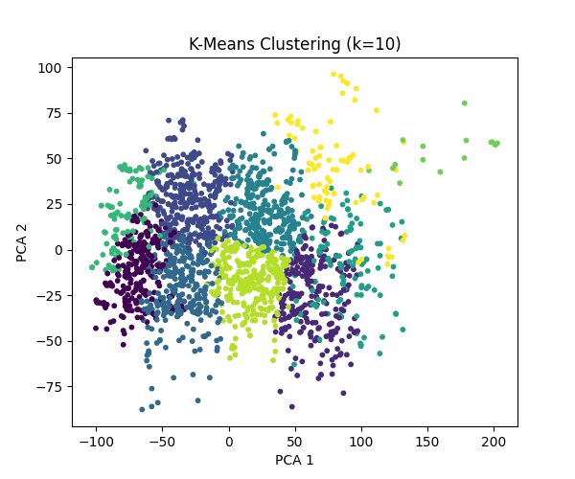
Clustering with k = 10
The clusters begin to overlap more, and the boundaries between them become less distinct.
Increasing k leads to finer partitions, but many clusters appear redundant or too close together.
Some central clusters may represent over-splitting of broader categories.

Slide 17
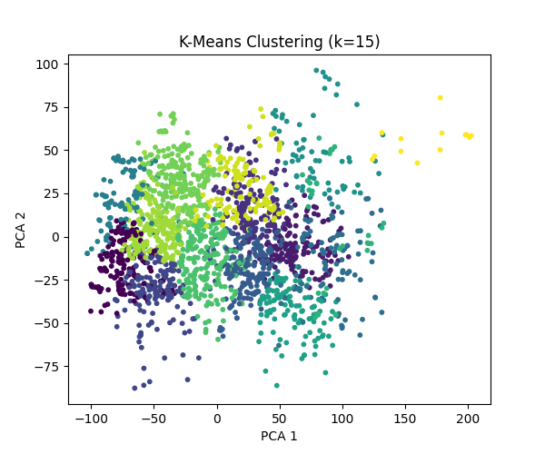
Clustering with k = 15
Over-segmentation is more evident; many clusters occupy similar areas in PCA space.
This higher k value introduces noise, potentially capturing minor variations rather than meaningful patterns.
Useful only if the goal is to identify highly granular subpopulations for further analysis, otherwise not ideal
General Observation:-
Best k visually appears to be around 5, as it strikes a balance between separation and interpretability.
As k increases, the clarity of groupings decreases, which may reduce the usefulness of clusters for practical classification.
This clustering validates that there is latent structure in the data, but it doesn’t directly align with the original 3-class labels — confirming that unsupervised learning reveals more nuanced patterns than those captured in the labeled classes.

Slide 18
Conclusion
In this project, I designed machine learning-based system to classify fetal health using Cardiotocogram (CTG) data. Models like Random Forest, Logistic Regression, and XGBoost were trained, with Random Forest achieving the best performance across all the metrics ROC AUC: 0.9785, F1 Score: 0.9276, PR AUC: 0.9361.
To improve performance, we applied SMOTE for class balancing and selected the top 10 features using correlation analysis. Clustering with K-Means and PCA visualization further revealed hidden patterns in the data.
The results demonstrate that machine learning can effectively support fetal health assessment, enabling early intervention and contributing to the reduction of maternal and child mortality, especially in low-resource settings.

Slide 19
Thank You!!!!!

